Slide 1
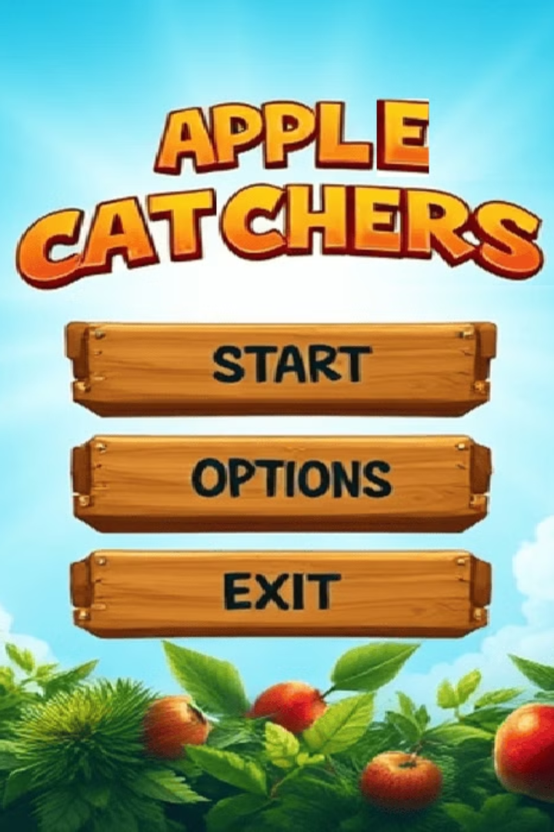
APPLE CATCHERS: A C++ Game
Welcome to "APPLE CATCHERS," a fun and engaging arcade game developed in C++ using the Raylib library.

Slide 2
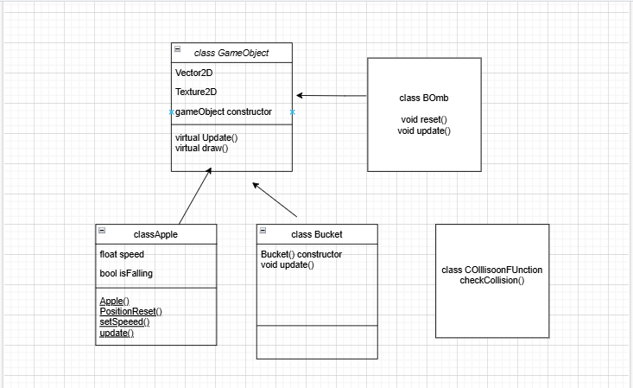

Slide 3
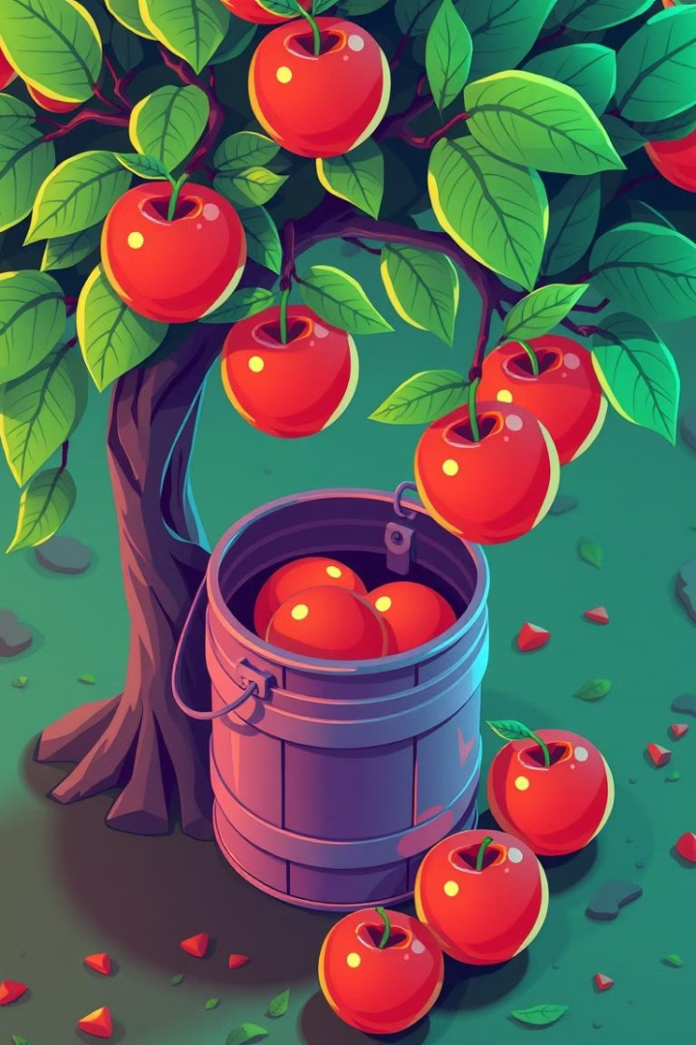
Project Introduction
1
1. Simple Gameplay
2
2. Score System
Catch apples falling from a wide tree using a horizontally moving bucket.
Catch apples to increase score, miss apples to decrease score.
3
3. C++ and Raylib
Demonstrates core game development concepts using C++ and the Raylib library.

Slide 4
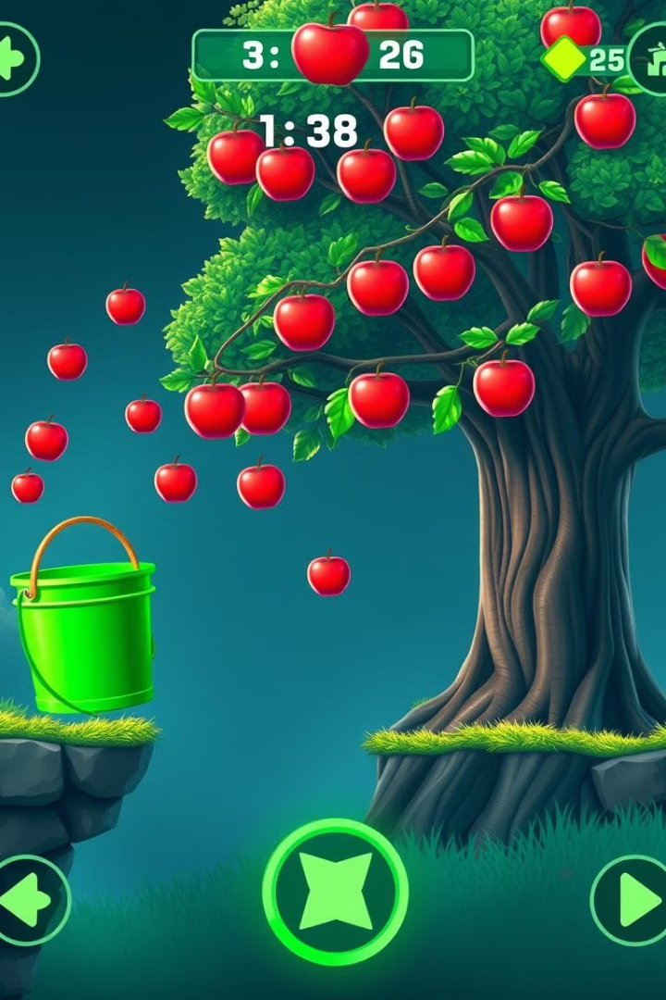
Game Mechanics
1
Player controls bucket using arrow keys or mouse to move left and right.
2
Apples fall from the tree at random positions and speeds, with increasing difficulty over time.
3
Successful catches increase score, while misses decrease score, challenging the player to stay focused.

Slide 5

Technological Stack
C++
Raylib
The primary programming language for game logic and functionality.
A powerful and cross-platform library for graphics, input, and game development.
Visual Studio (or IDE)
A robust development environment for coding and debugging C++ projects.

Slide 6



Future Enhancements
Power-ups
Add items like magnet to attract apples or extra lives to increase player resilience.
Leaderboards
Implement a leaderboard to display player rankings and foster competitive spirit.

Slide 7

Conclusion
Thank you for your time. We are excited about the potential of "APPLE CATCHERS" and look forward to developing it further. We believe this project will be a valuable educational tool and a fun game for everyone.

